Slide 1
Student Finance
2023
Sally Armstrong

Slide 2
Session content
Student Finance Package
How to apply
Repayment
Questions

Slide 3
Qualifying
There are three main conditions a student has to meet:
They must be personally eligible
The course must be eligible
The university or college must also be eligible

Slide 4
What is available?
Tuition Fee Loan
Maintenance Loan
University or College Bursaries and Scholarships
Extra support for special circumstances

Slide 5
Tuition fee loan

Slide 6
What is household income?

Slide 7
Maintenance loan

Slide 8
 | All eligible students can apply for this | Depending on household income you could also get up to | Max. Loan
Studying outside of London and not living with parents | £4,561 | £5,327 | £9,978
Studying in London and not living with parents | £6,485 | £6,537 | £13,022
Living in parents’ home | £3,698 | £4,702 | £8,400
Overseas | £5,524 | £5,903 | £11,427

Slide 9
Students with household incomes above the following amounts can only receive unassessed proportion:
Outside London: £62343
London: £70040
At home: £58291
Income in between these figures is reduced:
Outside London: £1 for every £7.01 above £25000
London: £1 for every £6.89 above £25000
At home: £1 for every £7.08 above £25000

Slide 10
Example:
Household income of £55000
Student outside London
£55000 less £25000 = £30000.
Divide by £7.01 = £4279
Maximum loan = £9978 less £4279 =
£5699 receivable

Slide 11
Parental contribution
Household income up to £42875 – none
Increases up to thresholds of:
Outside London: £62343
London: £70040
At home: £58291
Outside London: £2778
London: £3943
At home: £2178

Slide 12
Example:
Household income of £55000
Student outside London
£55000 less £42875 = £12125
Divide by £7.01 = £1729.67 (round up)
Contribution = £1730

Slide 13
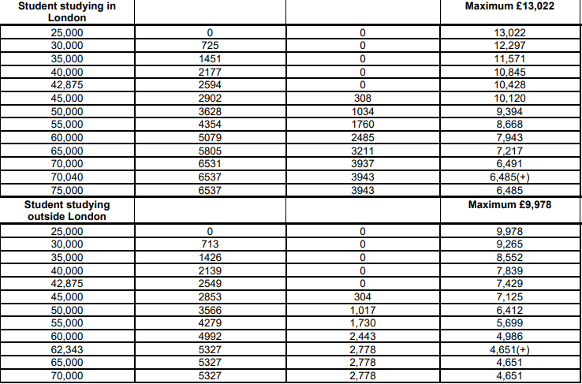
Income assessment
Assessed contribution

Slide 14
Other support
University and college bursaries and scholarships
NHS Funding
Extra help for students in special circumstances, for example students with a disability
Support for part-time courses.

Slide 15
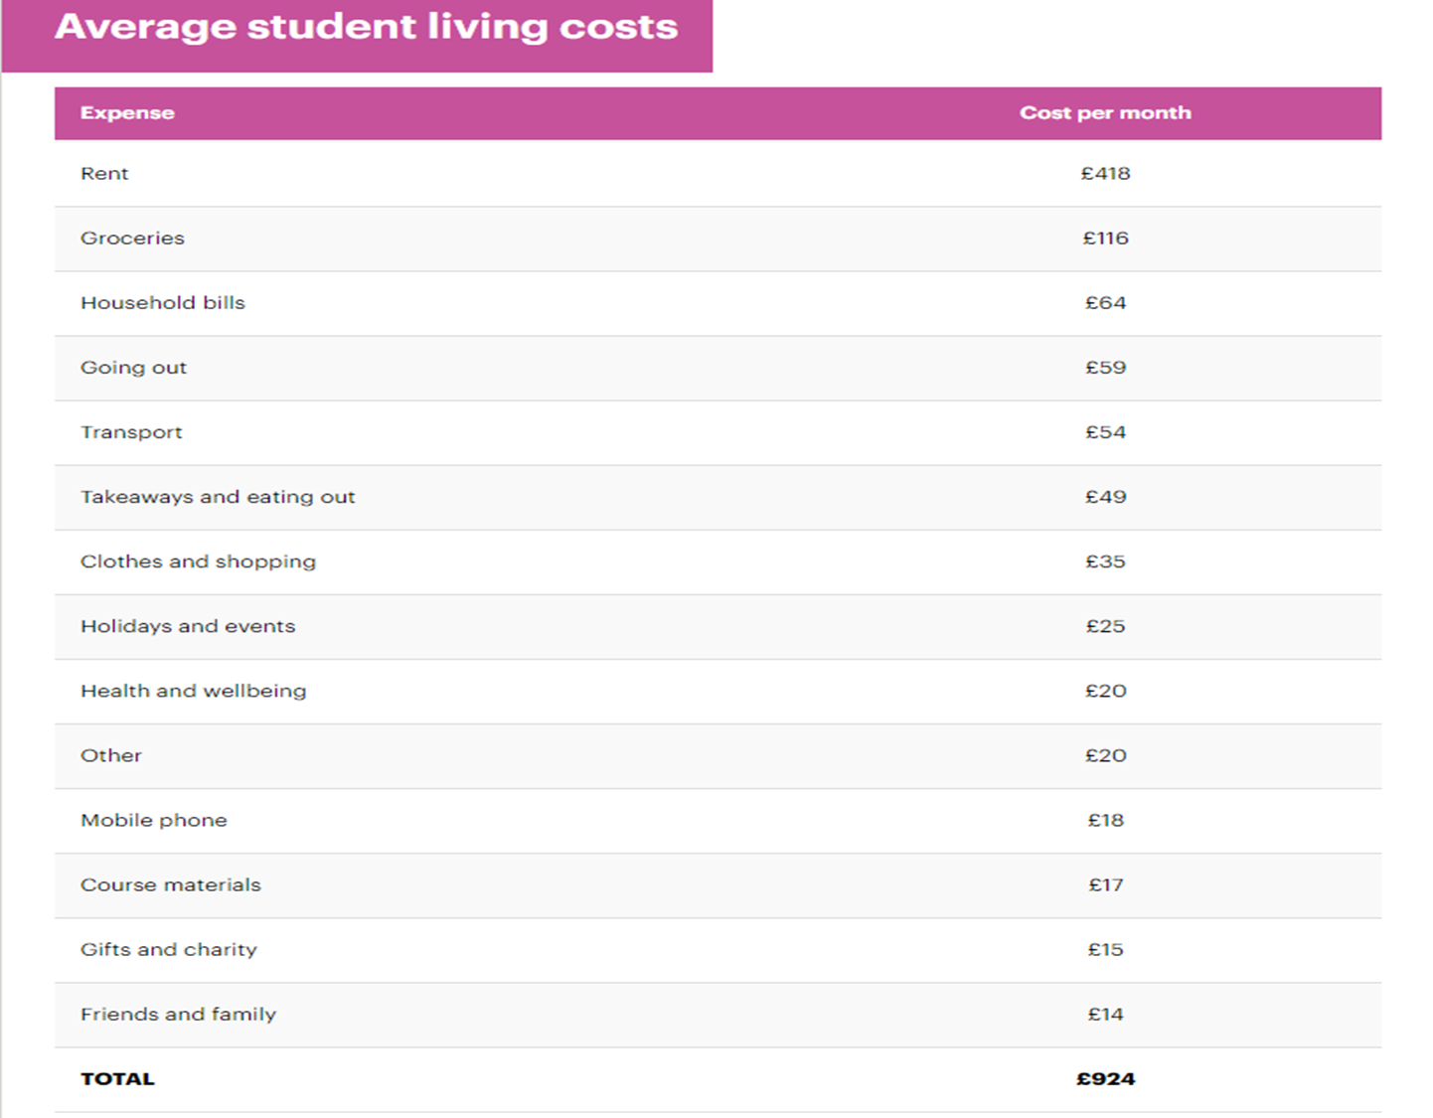

Slide 16
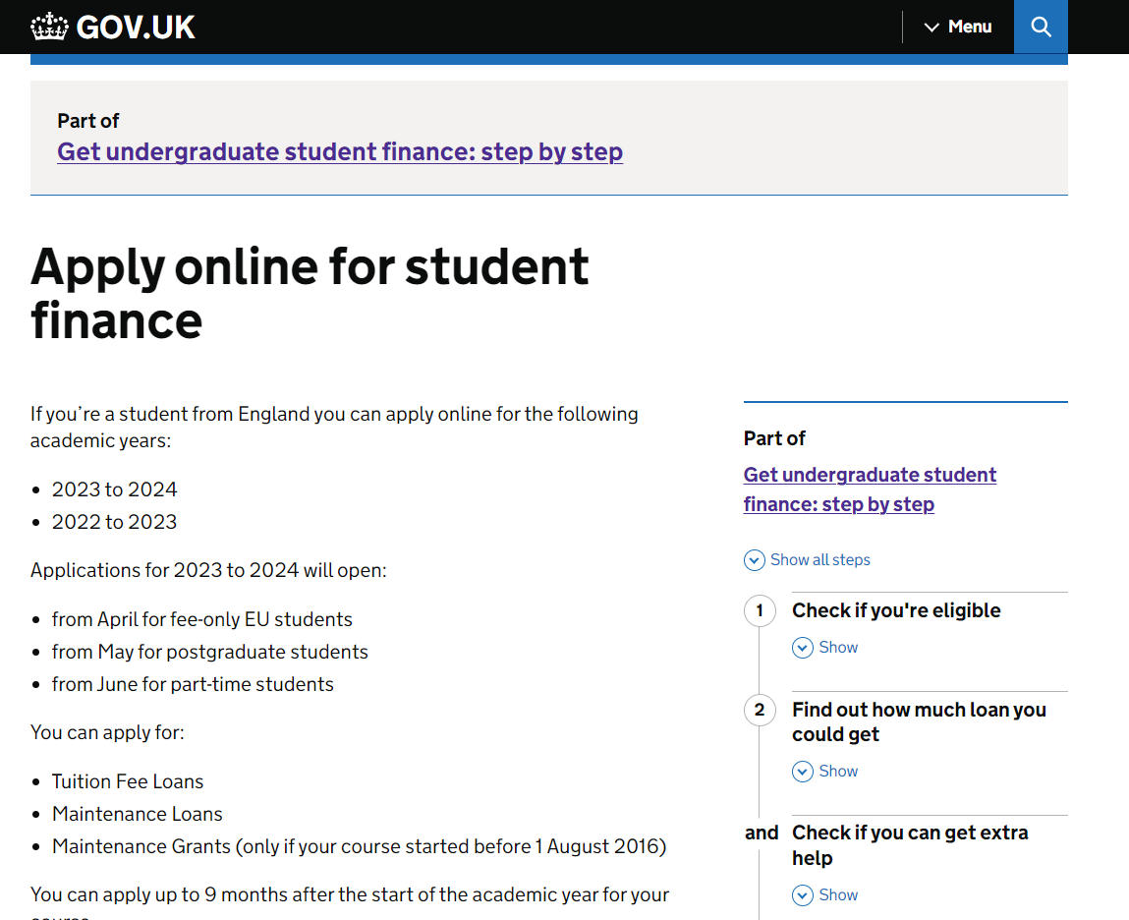

Slide 17
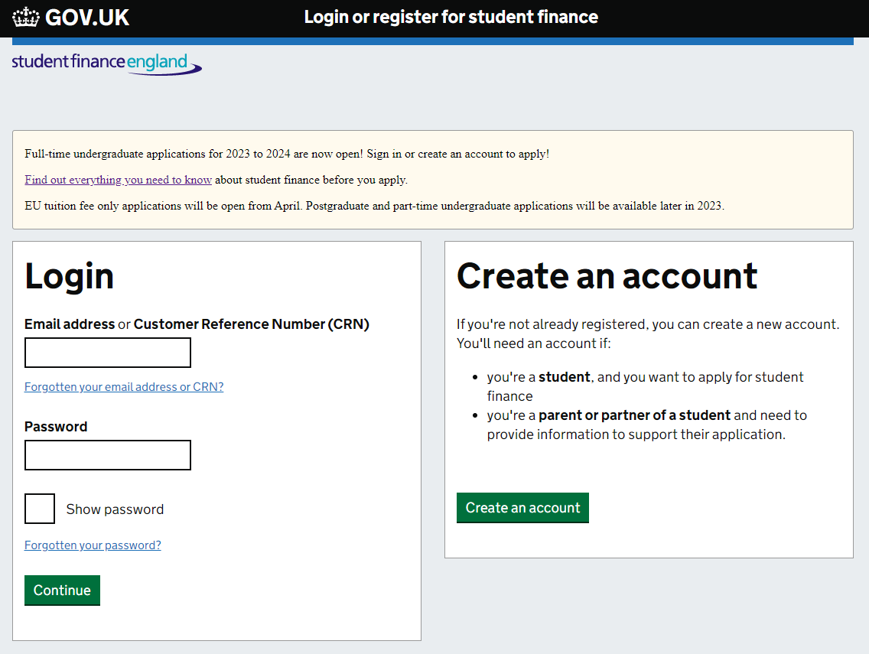

Slide 18
Repaying the loans
Paid on earnings over £25000
9% of income over threshold
Deducted from salary through the tax system
Any outstanding balance written off by government after 40 years
Interest at RPI

Slide 19
Annual income before tax | Monthly salary | Monthly repayment
Up to £25,000 | £2,083 | £0
£28,000 | £2,333 | £22
£29,500 | £2,458 | £33
£31,000 | £2,583 | £45
£33,000 | £2,750 | £60

Slide 22
gov.uk/student-finance
studentfinance.campaign.gov.uk/
thescholarshiphub.org.uk
moneysavingexpert.com/students/
www.gov.uk/disabled-students-allowance-dsa
www.nhsbsa.nhs.uk/nhs-learning-support-fund-lsf
Thank you

