Slide 1

Student Finance
2022
Sally Armstrong

Slide 2
Session Content
Student Finance Package
Repayment
How to apply
Questions

Slide 3
Qualifying
There are three main conditions a student has to meet:
  They must be personally eligible
  The course must be eligible
  The university or college must also be eligible

Slide 4
What student finance is available?
Tuition Fee Loan
Maintenance Loan
University or College Bursaries and Scholarships
Extra support for special circumstances

Slide 5
Tuition Fee Loan
Tuition fee level of up to £9,250 per year
Available to all eligible students
Not based on household income
Paid by Student Finance England direct to university or college
Repayable when the student finishes or leaves the course and students must
Apply every year
SALLY ARMSTRONG

Slide 6
What is Household Income?
Student’s income
Parents’ income
Deductions – certain pension payments
£1130 for each dependent child
Changes in income

Slide 7
Maintenance Loan
To help with living costs - entitlement depends on:
Household income
proportion not dependent on household income
proportion dependent on household income
Where you live while you are studying
Year of course
Repayable when the student finishes or leaves the course and students must
Apply every year.

Slide 8
Maintenance Loan
 | All eligible students can apply for this | Depending on household income you could also get up to | Max. Loan
Studying outside of London and not living with parents | £4,524 | £5,182 | £9,706
Studying in London and not living with parents | £6,308 | £6,359 | £12,667
Living in parents’ home | £3,597 | £4,574 | £8,171
Overseas | £5,374 | £5,742 | £11,116

Slide 9
What will your son or daughter be able to borrow?
Students with household incomes of £25000 or less receive maximum loan
Students with household incomes above this have their loans reduced.
Outside London - £1 for every £7.20 above £25000
London - £1 for every £7.08 above £25000
Home - £1 for every £7.27 above £25000
Example:
Household income of £55000. Student outside London
£55000 less £25000 = £30000.
Divide by £7.20 = £4166
Maximum loan = £9706 less £4166 = £5540 receivable.

Slide 10
What will parents have to pay?
Household income up to £42875 – none
Household income of more– assessed contribution
Example: Household income of £55000
Student studying outside London
Contribution disregard (amount between 25000 and 42875)
£42875-£25000 = £17875 / £7.20 = £2482
Previous calculation = £4166 less £2482 = £1694
Student could receive £5540 + £1694= £7234

Slide 11
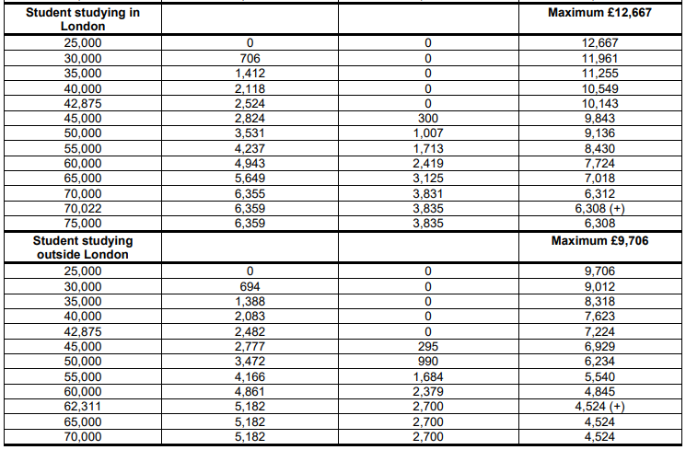
Income assessment
Assessed contribution

Slide 12
Other Support
University and college bursaries and scholarships
NHS Funding
Extra help for students in special circumstances, for example students with a disability
Support for part-time courses.

Slide 13
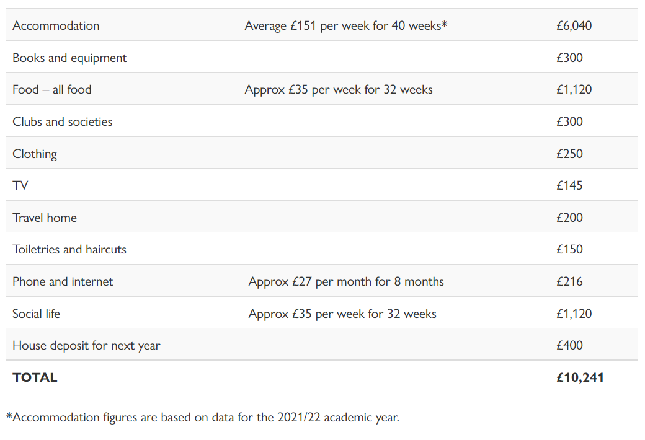

Slide 14
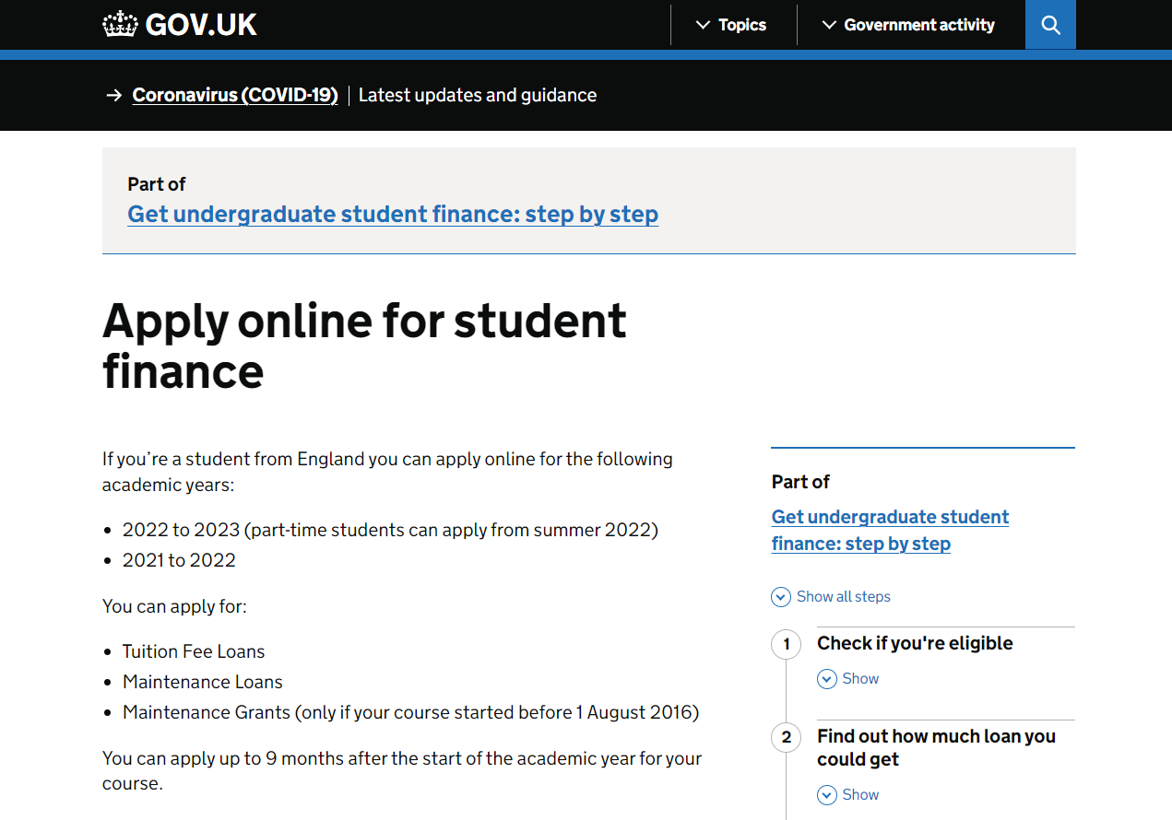

Slide 15
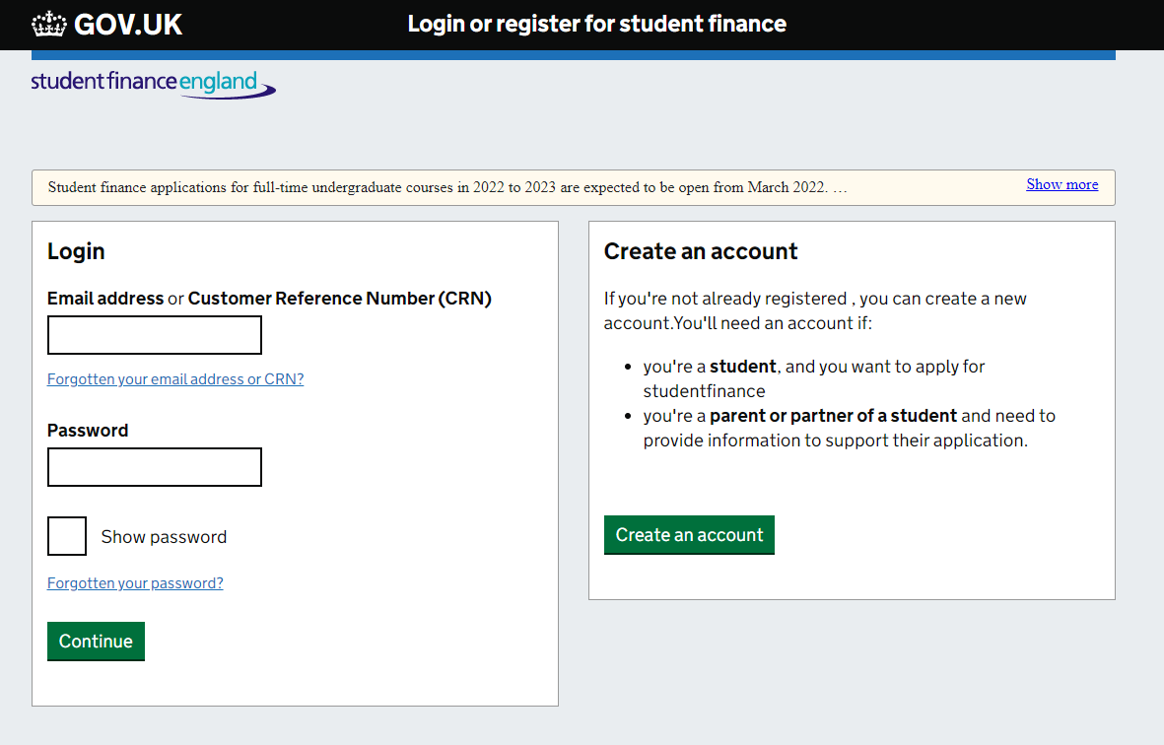

Slide 16
Repaying the Loans
Paid on earnings over £27,295
9% of income over £27,295
Deducted from salary through the tax system
Any outstanding balance written off by government after 30 years.

Slide 17
Annual income before tax | Monthly salary | Monthly repayment
Up to £27,295 | £2,275 | £0
£28000 | £2,333 | £5
£30,000 | £2,500 | £20
£35,000 | £2,917 | £57
£40,000 | £3,333 | £95

Slide 18
Interest rates
RPI plus 3%
Earnings below £25000
RPI
Earnings between 25,000 and £45,000
RPI plus up to 3%
Earnings over £45,000
RPI plus 3%
Whilst studying

Slide 19
Applying and receiving funds
Register and complete student finance application
Submit additional evidence if necessary
SFE approves application
Sends Student Finance Entitlement letter
and declaration
Sign and return the declaration
Take Entitlement letter to university for registration
SFE makes payments

Slide 20


Slide 21


Slide 22


Slide 23
gov.uk/student-finance
thestudentroom.co.uk/student-finance/
thescholarshiphub.org.uk
moneysavingexpert.com

