Slide 1
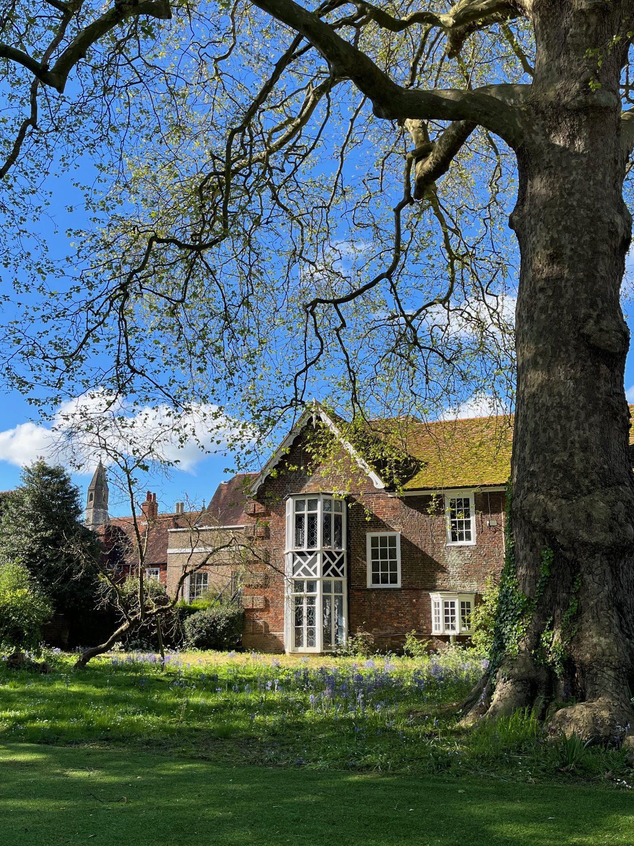
Applying
to
University
2027
Sally Armstrong

Slide 2

Apprenticeships

Slide 3

Advanced
Higher
Degree

Slide 4
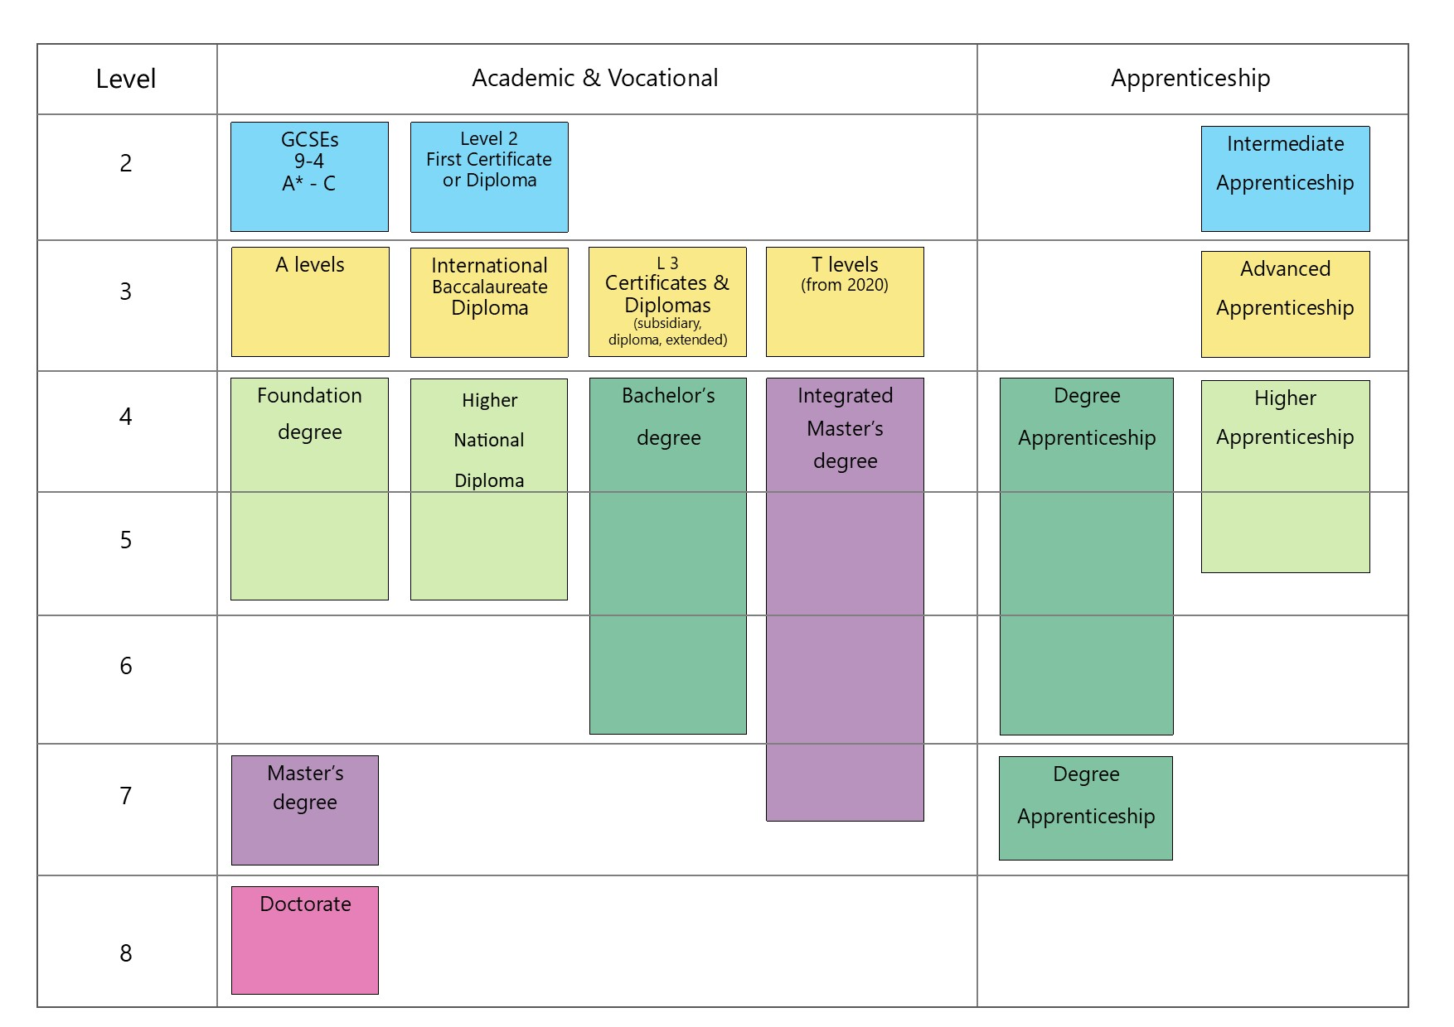

Slide 5
An introduction to
Higher
Education
How to make an application
Funding
Support from BWS
The value of HE

Slide 6
Ancient
Redbrick/Civic
Plate Glass
Post 1992
Russell Group

Slide 7
Qualifications offered
Foundation/HND
Bachelor’s
Integrated Master’s
Foundation
Types of first degree
Single Honours
Joint honours
Combined
Major/minor
Sandwich

Slide 8
Subjects
A level subjects
New
Vocational
Institutions
Size
Location
Facilities
Accommodation
League tables

Slide 9
How to Apply
UCAS
The process
October 15
January 13
Extra and Clearing
Admissions tests
Conservatoires
Art and Design - Foundation courses

Slide 10
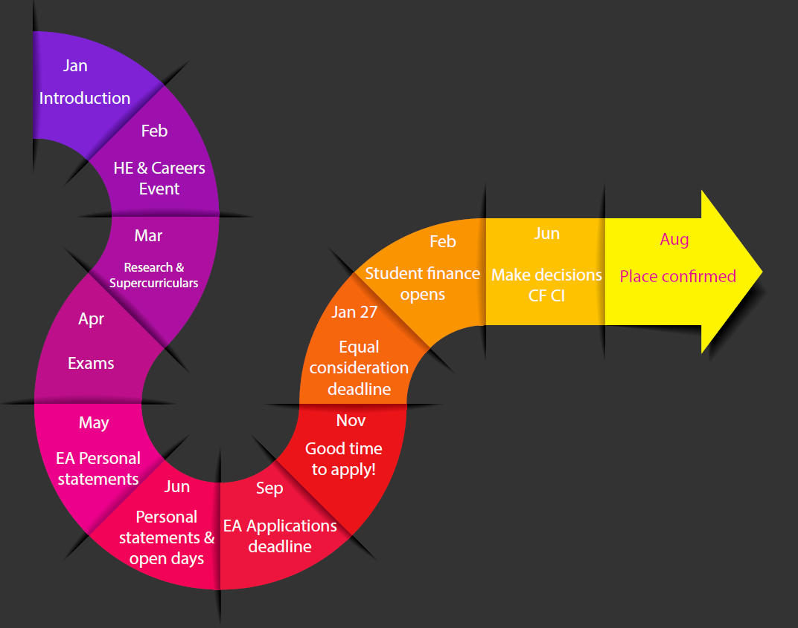

Slide 11


Slide 12
Personal statement
Question 1:
Why do you want to study this course or subject?
Question 2:
How have your qualifications and studies helped you to prepare for this course or subject?
Question 3:
What else have you done to prepare outside of education, and why are these experiences useful?

Slide 13
Funding
Fee loan
Living expenses loan
Scholarships and bursaries
Repayments

Slide 14
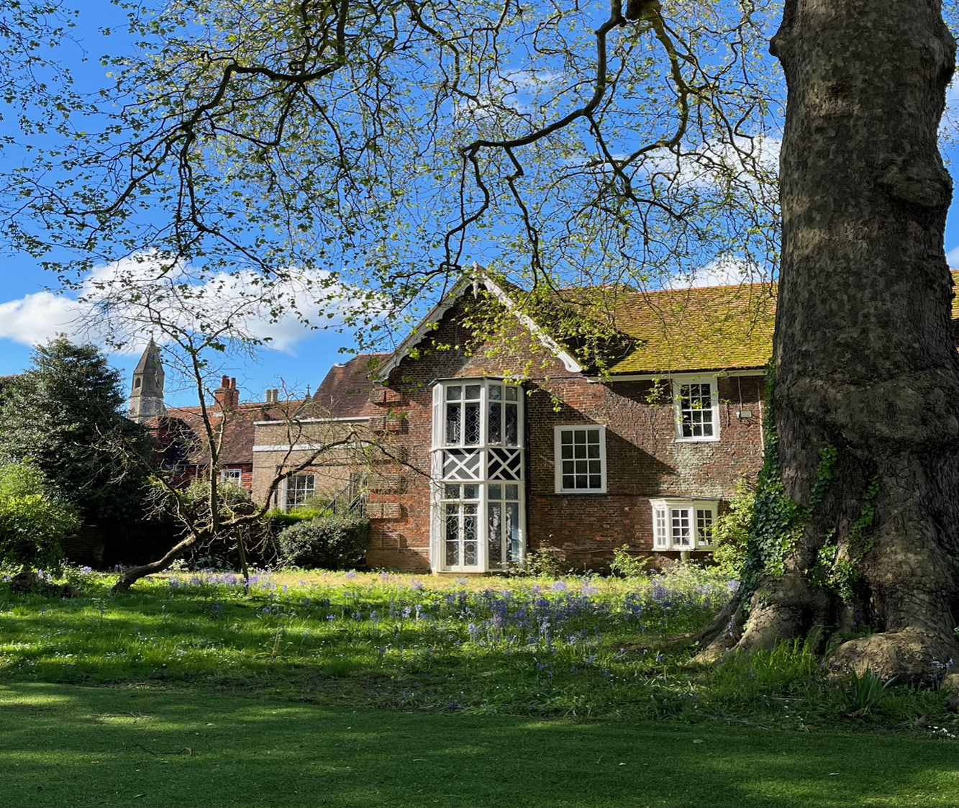
Introductory Talk
HE and Careers Event
Apprenticeship event
Oxbridge Talk
Post exams Workshops
Personal Statements
UCAS Registration
University visits
Preparation for entry tests
Guidance interviews

Slide 15
Supercurricular engagement
Careers meetings
Visits
BWS UCAS Predicted grades

Slide 16


Slide 17
The value of Higher Education
To improve career prospects
To pursue a vocational path
To earn a larger salary
To develop skills for employment
To build self-confidence, independence and responsibility
Networking opportunities
Social and recreational opportunities

